Slide 1
1A: Product Guide
Browser-based
User-interface
Web server
Database
Prices
Reference data
Market data
Excel-based (Xcelsius) font-end
Other internal systems
(Optional) : Integration with internal systems (DEV / UAT environments)
Prices
Market data
News

Slide 2
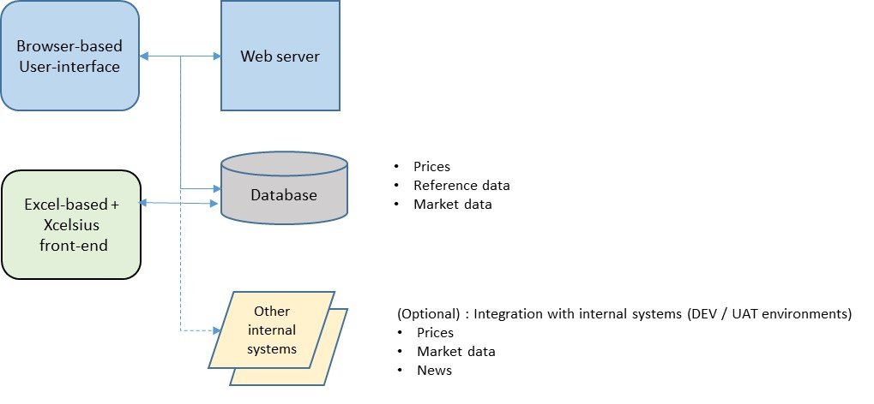
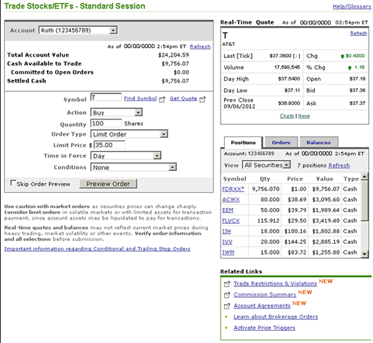
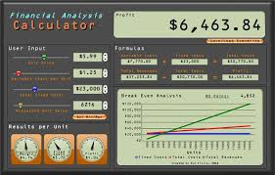
1A: Product Guide
Example of browser-UI:
Example of Xcelsius:

Slide 3
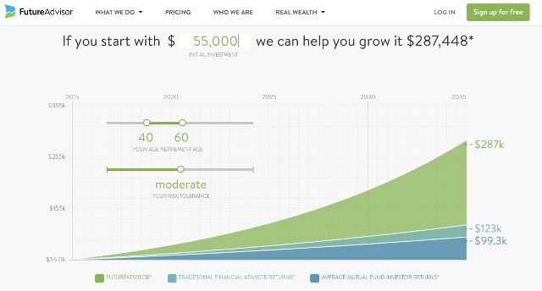
1A: Product Guide
Example of browser-UI:
Example of Guided Decision tool:
Investment steps :
Simple language :

Slide 4
1A: Product Guide
For examples:
Dev choice – e.g. Java, .Net, etc.
Other technical design – e.g. HTML5 ?
Coding / development platform
Web server
Database
Other optional items: charting tools
Structured Product Guide : Proposed Steps:
Define high-level technology requirements for web (browser-based) app
Assign 1 person to learn, build and evaluate Xcelsius tool. Provide name by Mon. 05-Dec. ( Requirement: Good knowledge of Excel; VBA may be helpful; able to learn on their own )
Define development and deployment architecture
Setup development environment
Create simple prototype / proof-of-concept showing simple calculator using data from database ( Abbas will prototype design and the sample data for the database )
Expected / Proposed Time for above: 01-Dec-2016 to 02-Jan-2017

Slide 5
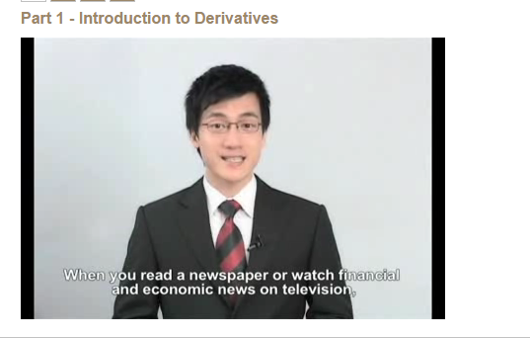
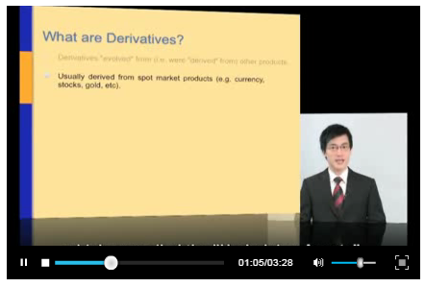
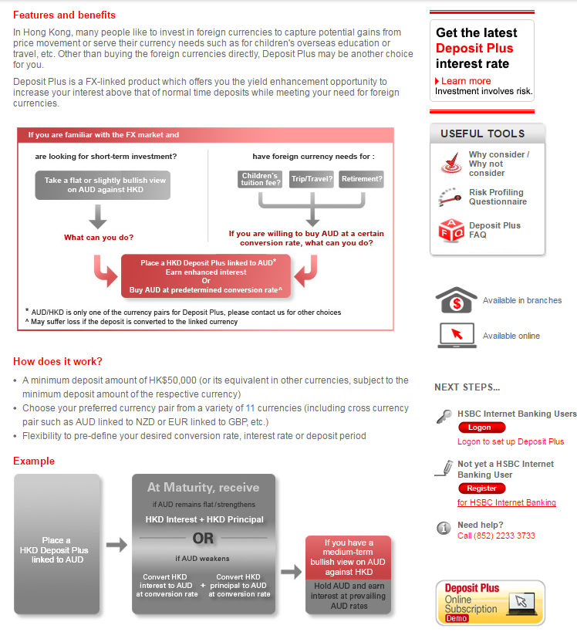
1b: Interactive Product Education
Topics :
Derivatives knowledge
Currency-linked deposits
Equity-linked investments

Slide 6

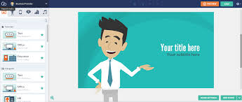
1b: Interactive Product Education
Potential tools:
White-board animation:
Tool: Videoscribe
Tool: GoAnimate
“Motion Graphics”:
To Be Determined (TBD)

Slide 7
1b: Interactive Product Education
Most banks in HK use same video:
https://www.credit-suisse.com/hk/en/about-us/legal/investor-education.html
http://www.citigold.com.hk/english/investment/derivative-product-basic.htm?lid=HKENCBLIVCATLDerivativeProductBasicsIVSP
https://www.dbs.com.hk/personal/investments/derivatives-video-training
HSBC uses their own video:
http://www.broking.hsbc.com.hk/1/2/broking/misc/ictraining
Derivatives Knowledge : Proposed Steps:
Review the “Derivatives Knowledge” videos currently available
Learn about derivatives and structured products.
Using My Learning (link) to find e-learning courses
Using videos on internet (e.g. Youtube)
Use education on internet (e.g. see “Futures and Options” and “Structured products” on https://www.thechinfamily.hk/web/en/financial-products/investment/index.html )
Define better way to educate customers on Derivatives:
So that it is easier to use
More effective use of time
Better to understand and remember the content
The education is relevant and can be used for investing in Structured Products
Create overview and outline of how the Derivatives Knowledge content can be presented to customers. Add sample information, to give example of content (text, images, charts, etc.)
Products to focus on:
Derivatives : (i) Forwards/Futures, (ii) simple call and put Options
Structured Products:
(a) Currency-linked deposits (which we call “Deposit Plus”)
(b) Equity-linked investments with features: Airbag, Early Call, and Daily Accrual.
Examples of MyLearning courses:
Derivative Contracts: Futures, Forwards, Swaps, and Options (ELEARNING SST_fini_09_a01_bs_enus)
Structured Products - An Introduction (ELEARNING INT_LO_3588)

